Slide 1




Data Visualisation
TikTok Trending Videos Analysis
Tongova, Han
Diaz Maciel, Matheus
Chuntararuangnapa, Sirada
Kara-Ool, Anchenmaa

Slide 2

Agenda
Introduction
Analysis Plots
Conclusion

Slide 3

Introduction
TikTok is a video social networking service owned by ByteDance.
We are analysing a data set containing TikTok’s 1000 most popular videos with the objective of visualising and explaining
‘What makes a TikTok video popular’.

Slide 4


PLOT 1
Impact of Song
& Artist on Likes

Slide 5
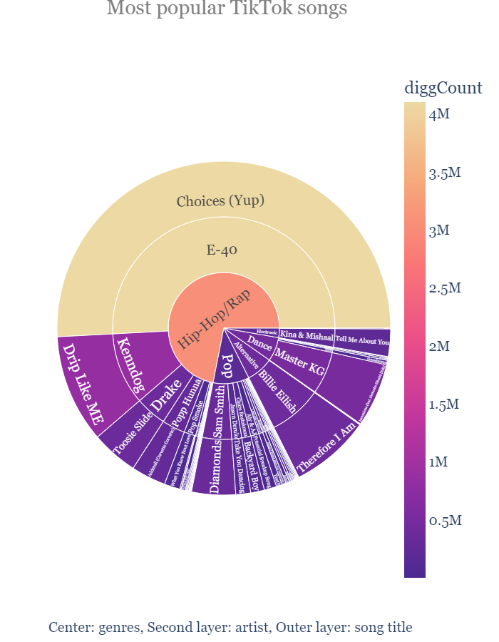
(Multi-layered sunburst graph)
The chart displays song genres, artists, song names to identify their popularity on TikTok, based on the amount of likes.
Popular TikTok video will have a Hip-Hop/Rap song attached to it with other genres such as Electronic being the least popular choice.
Those who choose to use a Hip-Hop/Rap song will also have a lot more options of what song to choose exactly that could all make the video popular.

Slide 6
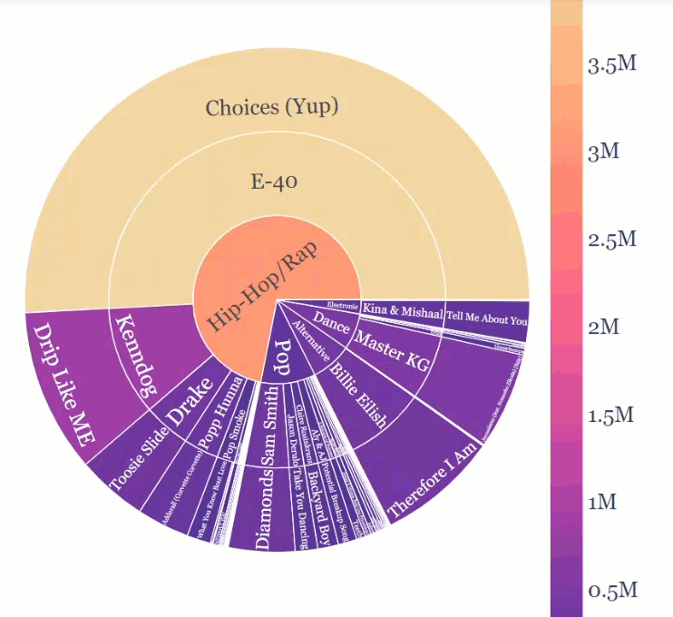
Most Popular TikTok Song
(Multi-layered sunburst graph)
The chart displays song genres, artists, song names to identify their popularity on TikTok, based on the amount of likes.
Popular TikTok video will have a Hip-Hop/Rap song attached to it with other genres such as Electronic being the least popular choice.
Those who choose to use a Hip-Hop/Rap song will also have a lot more options of what song to choose exactly that could all make the video popular.
Center: genres, Second layer: artist, Outer layer: song title

Slide 7
PLOT 2
Impact of Hashtag on
Total Engagement

Slide 8
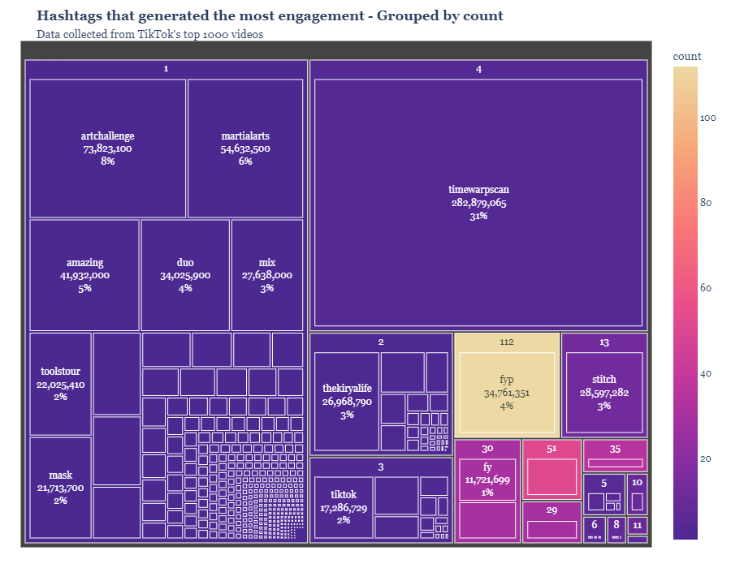
(Treemap plot)
The plot represent information of Hashtags count, the number of times a hashtag was repeated across the 1000 videos dataset, and total engagement - the total amount of likes, comments, views and shares.
Most used hashtags are not always the most popular with hashtags being repeated hundreds of times amassing lower engagement than some that were only used once or twice.
However, it also has to be noted that some of these only generated a one-off engagement as the video goes viral.

Slide 9
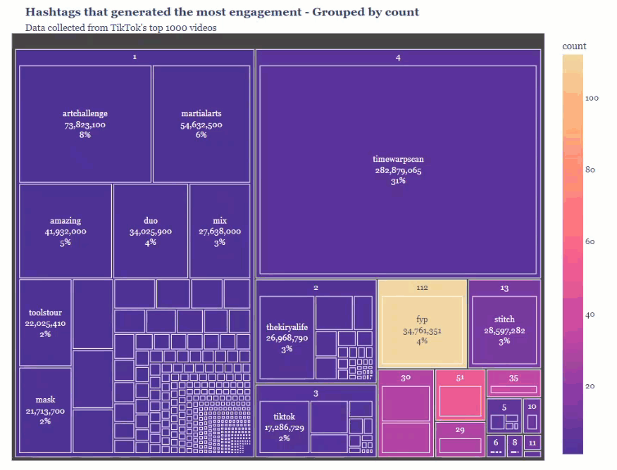
(Treemap plot)
The plot represent information of Hashtags count, the number of times a hashtag was repeated across the 1000 videos dataset, and total engagement - the total amount of likes, comments, views and shares.
Most used hashtags are not always the most popular with hashtags being repeated hundreds of times amassing lower engagement than some that were only used once or twice.
However, it also has to be noted that some of these only generated a one-off engagement as the video goes viral.

Slide 10
PLOT 3
Best time to post & video length - based on likes

Slide 11
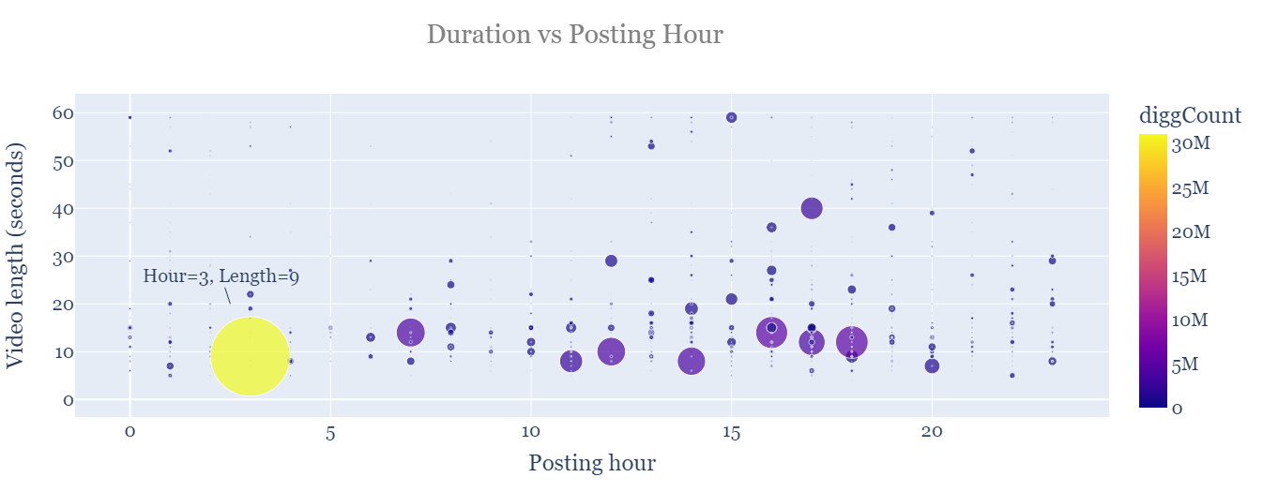
(Bubble scatter plot)
The final chart displayed what is the optimal time to post a TikTok video as well as its length.
The optimal video length is less than 10 seconds whilst the best posting time is 3AM on the dataset’s time zone.
Unfortunately, the time zone isn’t indicated, impeding us from converting it to UK time to better understand this characteristic.

Slide 12
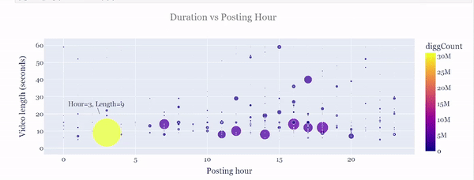
(Bubble scatter plot)
The final chart displayed what is the optimal time to post a TikTok video as well as its length.
The optimal video length is less than 10 seconds whilst the best posting time is 3AM on the dataset’s time zone.
Unfortunately, the time zone isn’t indicated, impeding us from converting it to UK time to better understand this characteristic.

Slide 13

Conclusion:
How to make your TikTok videos popular
The selection of an appropriate hashtag can make a great difference on a video’s popularity.
A safe choice is the ‘fyp’ hashtag and its offshoots such as ‘foryoupage’. These are widely repeated tags that mass great popularity.
The best choice is for a hip-hop/rap song.
Specific artists include, for example, Drake who is often ranked in the top of the music charts worldwide.
The optimal length of a video should be of less than 10 seconds.
The app is a very dynamic social network, mostly used by younger audiences and thus longer videos are often overlooked.

Slide 14


Thank you
-End of Document-

